Slide 1

Reinforcement Learning Crypto Currency
Caden Aragon & Jacob Quatkemeyer

Slide 2
Recap
Agent that uses Q-Learning and Deep-Q to make crypto market decisions
Will learn how to efficiently make actions, buy, sell, and hold, by reading indicators
To buy coins, we need an arbitrary starting balance, which is also used to determine rewards.
The agent will be rewarded with the change in the portfolio value for each hour.
Holding rewards 0
Buying rewards -100, the set amount that will always be used when buying coins
Selling rewards the amount that is earned when trade is closed.

Slide 3
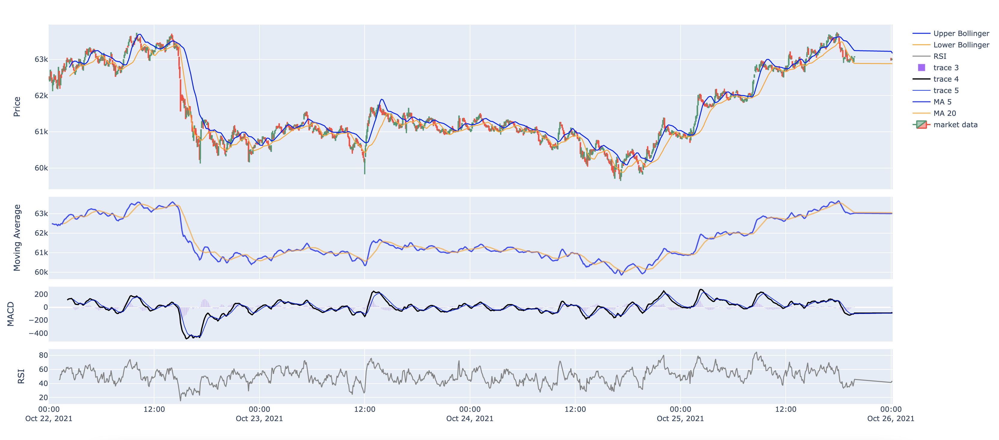
Visualization

Slide 4
Our Approach
Q-Learning
Time step will be on the hour
Episode is 60 days
State space is the indicators
Reward - every hour

Slide 5
Evaluation
Sharpe Ratio
Expected profit account for loss
Win – when a profitable sale happens
Loss – when a loss has happened

Slide 6
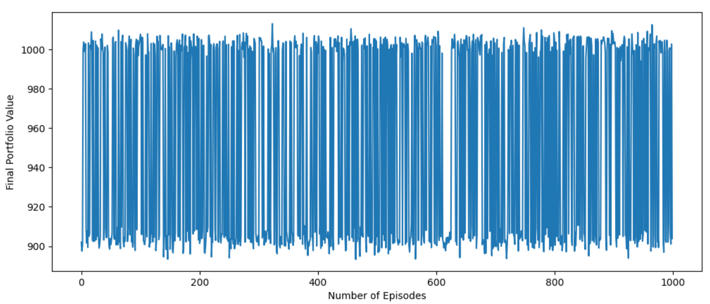
Results From Basic Q – Learning A Spectacular (and expected) Failure

Slide 7
Q – Learning Limitations
The state space is far too large to successfully train an agent
The state space can be simplified by using ratios, and comparisons.
The computing takes far too long for even a limited amount of episodes
Deep Q – Learning will ideally compute much more efficiently.

Slide 8
Timeline
Begin Deep Q
Implement a Deep Q learning approach
Evaluate Results
Depict Results
Complete final paper and presentation
Determine if either approach is a viable option

Slide 9
References
Akhil Raj Azhikodan, Anvitha G. K. Bhat, and Mamatha V. Jadhav. “Stock Trading Bot Using Deep Reinforcement Learning”. In: Innovations in Computer Science and Engineering. Springer Singapore, 2019.
Jagdish Bhagwan Chakole et al. “A Q-learning agent for automated trading in equity stock markets”. In: Expert Systems with Applications 163 (2021), p. 113761.
Marco Corazza. “Q-Learning-Based Financial Trading: Some Results and Comparisons”. In: Progresses in Artificial Intelligence and Neural Systems. Springer, 2021, pp. 343–355.
Quang-Vinh Dang. “Reinforcement Learning in Stock Trading”. In: Advanced Computational Methods for Knowledge Engineering. Cham: Springer International Publishing, 2020.
Boming Huang et al. “Automated trading systems statistical and machine learning methods and hardware implementation: a survey”. In: Enterprise Information Systems 13.1 (2019), pp. 132–144.
Jae Won Lee. “Stock price prediction using reinforcement learning”. In: 1 (2001), pp. 690–695.
Volodymyr Mnih et al. “Human-level control through deep reinforcement learning”. In: nature 518.7540 (2015), pp. 529–533.
Rommy Pramudya and Sakina Ichsani. “Efficiency of technical analysis for the stock trading”. In: International Journal of Finance & Banking Studies 9.1 (2020), pp. 58–67.
Melrose Roderick, James MacGlashan, and Stefanie Tellex. “Implementing the deep q-network”. In: arXiv preprint arXiv:1711.07478 (2017).
Yong Shi et al. “Stock trading rule discovery with double deep Q-network”. In: Applied Soft Computing 107 (2021), p. 107320.

